Slide 1
Big Data Analytics

Slide 2
Scope
Research issues
Existing big data tools
Big data architectures

Slide 3
Research issues
Volume, Velocity, Variety
Scalability
Data integration
Skills availability
Solution cost
Algorithms and tools redesign
Applicability limits
Making sense of the explosion of data
Understanding a growing variety of data

Slide 4
Research issues
Enabling real-time analysis of data
Achieving simplified deployment and management
Complexity
Privacy
Access and share
Data visualization:
Meeting the need for speed
Understanding the data
Addressing data quality
Displaying meaningful results
Dealing with outliers

Slide 5
Big trends in big data analytics
Big data analytics on cloud
Hadoop: the new enterprise data operating systems
Big data lake
More predictive analysis
Sql on hadoop
Nosql
Deep learning
In-memory analytics

Slide 6
EXISTING BIG DATA TOOLS

Slide 7
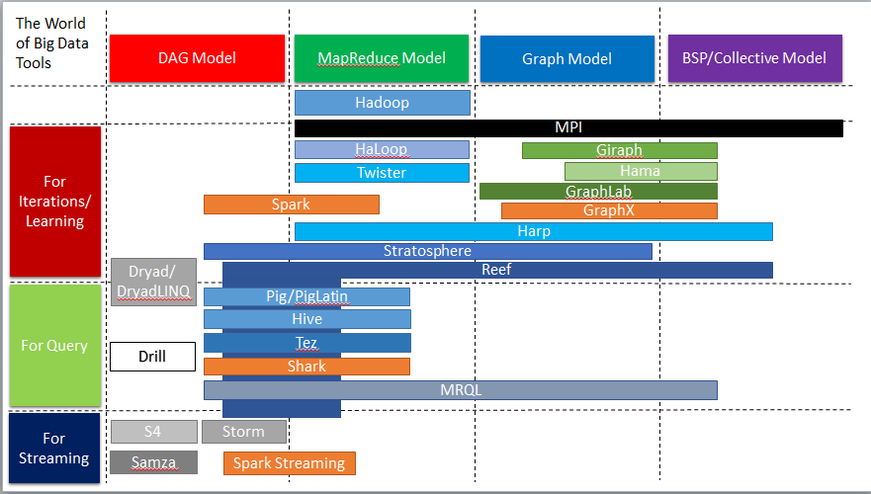
World map of big data tools

Slide 8
Big Data Tools for HPC and Supercomputing
MPI(Message Passing Interface, 1992)
Provide standardized function interfaces for communication between parallel processes.
Collective communication operations
Broadcast, Scatter, Gather, Reduce, Allgather, Allreduce, Reduce-scatter.
Popular implementations
MPICH (2001)
OpenMPI (2004)
http://www.open-mpi.org/

Slide 9
BIG DATA ANALYTICS TOOLS ON CLOUD

Slide 10

MapReduce Model
Google MapReduce (2004)
Jeffrey Dean et al. MapReduce: Simplified Data Processing on Large Clusters. OSDI 2004.
Apache Hadoop (2005)
http://hadoop.apache.org/
http://developer.yahoo.com/hadoop/tutorial/
Apache Hadoop 2.0 (2012)
Vinod Kumar Vavilapalli et al. Apache Hadoop YARN: Yet Another Resource Negotiator, SOCC 2013.
Separation between resource management and computation model.

Slide 11
Key Features of MapReduce Model
Designed for clouds
Large clusters of commodity machines
Designed for big data
Support from local disks based distributed file system (GFS / HDFS)
Disk based intermediate data transfer in Shuffling
MapReduce programming model
Computation pattern: Map tasks and Reduce tasks
Data abstraction: KeyValue pairs

Slide 12

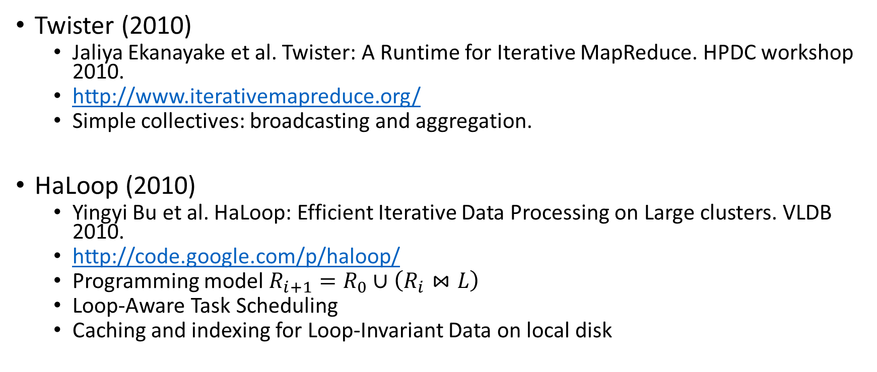
Iterative MapReduce Model

Slide 13
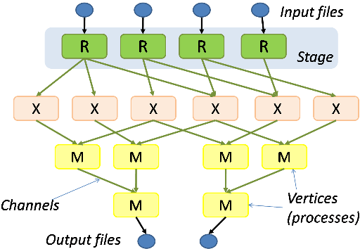
DAG (Directed Acyclic Graph) Model
Dryad and DryadLINQ (2007)
Michael Isard et al. Dryad: Distributed Data-Parallel Programs from Sequential Building Blocks, EuroSys, 2007.
http://research.microsoft.com/en-us/collaboration/tools/dryad.aspx

Slide 14

Model Composition
Apache Spark (2010)
Matei Zaharia et al. Spark: Cluster Computing with Working Sets,. HotCloud 2010.
Matei Zaharia et al. Resilient Distributed Datasets: A Fault-Tolerant Abstraction for In-Memory Cluster Computing. NSDI 2012.
http://spark.apache.org/
Resilient Distributed Dataset (RDD)
RDD operations
MapReduce-like parallel operations
DAG of execution stages and pipelined transformations
Simple collectives: broadcasting and aggregation

Slide 15


Graph Processing with BSP model
Pregel (2010)
Grzegorz Malewicz et al. Pregel: A System for Large-Scale Graph Processing. SIGMOD 2010.
Apache Hama (2010)
https://hama.apache.org/
Apache Giraph (2012)
https://giraph.apache.org/
Scaling Apache Giraph to a trillion edges
https://www.facebook.com/notes/facebook-engineering/scaling-apache-giraph-to-a-trillion-edges/10151617006153920

Slide 16

GraphLab (2010)
Yucheng Low et al. GraphLab: A New Parallel Framework for Machine Learning. UAI 2010.
Yucheng Low, et al. Distributed GraphLab: A Framework for Machine Learning and Data Mining in the Cloud. PVLDB 2012.
http://graphlab.org/projects/index.html
http://graphlab.org/resources/publications.html
Data graph
Update functions and the scope
Sync operation (similar to aggregation in Pregel)

Slide 17

Collective Model
Harp (2013)
https://github.com/jessezbj/harp-project
Hadoop Plugin (on Hadoop 1.2.1 and Hadoop 2.2.0)
Hierarchical data abstraction on arrays, key-values and graphs for easy programming expressiveness.
Collective communication model to support various communication operations on the data abstractions.
Caching with buffer management for memory allocation required from computation and communication
BSP style parallelism
Fault tolerance with check-pointing

Slide 18
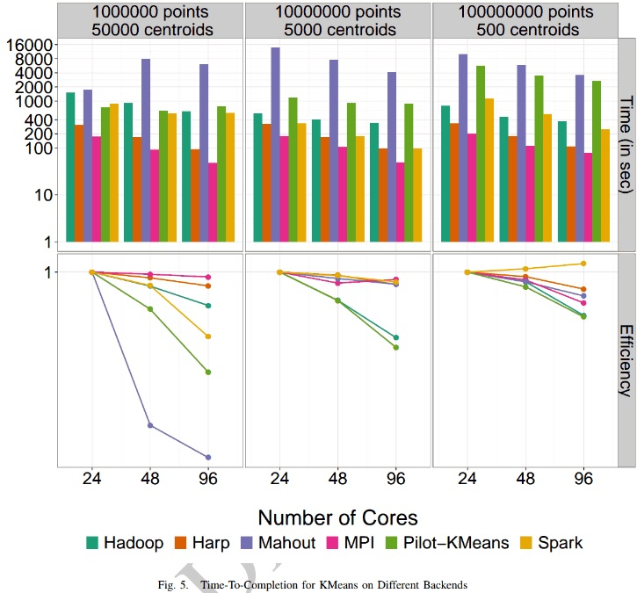
K-means Clustering Parallel Efficiency
Shantenu Jha et al. A Tale of Two Data-Intensive Paradigms: Applications, Abstractions, and Architectures. 2014.

Slide 19

Machine Learning on Big Data
Mahout on Hadoop
https://mahout.apache.org/
MLlib on Spark
http://spark.apache.org/mllib/
GraphLab Toolkits
http://graphlab.org/projects/toolkits.html
GraphLab Computer Vision Toolkit

Slide 20

Query on Big Data
Query with procedural language
Google Sawzall (2003)
Rob Pike et al. Interpreting the Data: Parallel Analysis with Sawzall. Special Issue on Grids and Worldwide Computing Programming Models and Infrastructure 2003.
Apache Pig (2006)
Christopher Olston et al. Pig Latin: A Not-So-Foreign Language for Data Processing. SIGMOD 2008.
https://pig.apache.org/

Slide 21

SQL-like Query
Apache Hive (2007)
Facebook Data Infrastructure Team. Hive - A Warehousing Solution Over a Map-Reduce Framework. VLDB 2009.
https://hive.apache.org/
On top of Apache Hadoop
Shark (2012)
Reynold Xin et al. Shark: SQL and Rich Analytics at Scale. Technical Report. UCB/EECS 2012.
http://shark.cs.berkeley.edu/
On top of Apache Spark
Apache MRQL (2013)
http://mrql.incubator.apache.org/
On top of Apache Hadoop, Apache Hama, and Apache Spark

Slide 22
Other Tools for Query
Apache Tez (2013)
http://tez.incubator.apache.org/
To build complex DAG of tasks for Apache Pig and Apache Hive
On top of YARN
Dremel (2010) Apache Drill (2012)
Sergey Melnik et al. Dremel: Interactive Analysis of Web-Scale Datasets. VLDB 2010.
http://incubator.apache.org/drill/index.html
System for interactive query

Slide 23
Stream Data Processing
Apache S4 (2011)
http://incubator.apache.org/s4/
Apache Storm (2011)
http://storm.incubator.apache.org/
Spark Streaming (2012)
https://spark.incubator.apache.org/streaming/
Apache Samza (2013)
http://samza.incubator.apache.org/

Slide 24
Apache Spark In-Memory Data Processing

Slide 25
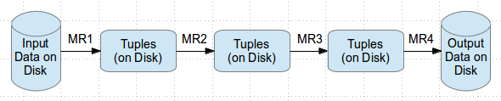
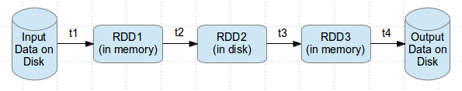
Why Spark ?
Most of Machine Learning Algorithms are iterative because each iteration can improve the results
With Disk based approach each iteration’s output is written to disk making it slow
Hadoop execution flow
Spark execution flow
http://www.wiziq.com/blog/hype-around-apache-spark/

Slide 26

About Apache Spark
Initially started at UC Berkeley in 2009
Fast and general purpose cluster computing system
10x (on disk) - 100x (In-Memory) faster
Most popular for running Iterative Machine Learning Algorithms.
Provides high level APIs in
Java
Scala
Python
Integration with Hadoop and its eco-system and can read existing data.
http://spark.apache.org/

Slide 27
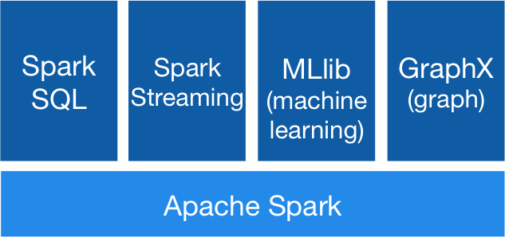
Spark Stack
Spark SQL
For SQL and unstructured data processing
MLib
Machine Learning Algorithms
GraphX
Graph Processing
Spark Streaming
stream processing of live data streams
http://spark.apache.org

Slide 28
How to select right platform/tools/technology??
Key questions
How quickly do we need to get the results?
How big is the data to be processed?
Does the model building require several iterations or a single iteration?

Slide 29
Technological concern
Will there be a need for more data processing capability in the future?
Is the rate of data transfer critical for such applications?
Is there a need for handling hardware failures within the application?

Slide 30
Scalable platforms
Scaling is the ability of the system to adapt to increased demands in terms of data processing.
Horizontal Scaling
Horizontal scaling involves distributing the workload across many servers which may be even commodity machines. It is also known as “scale out”, where multiple independent machines are added together in order to improve the processing capability. Typically, multiple instances of the operating system are running on separate machines.
Vertical Scaling
Vertical Scaling involves installing more processors, more memory and faster hardware, typically, within a single server. It is also known as “scale up” and it usually involves a single instance of an operating system.

Slide 31
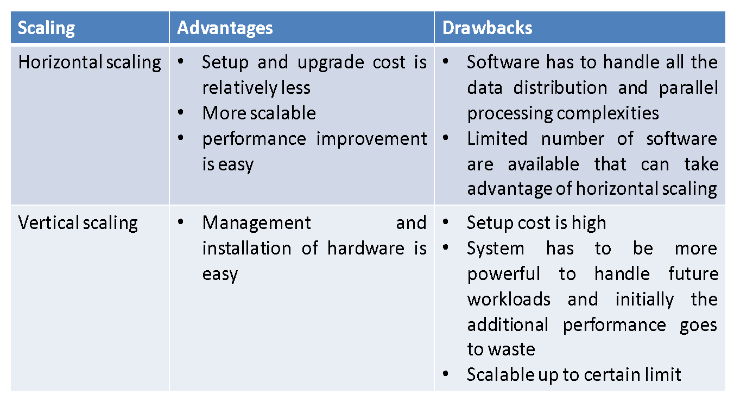
Big data Hardware platforms

Slide 32
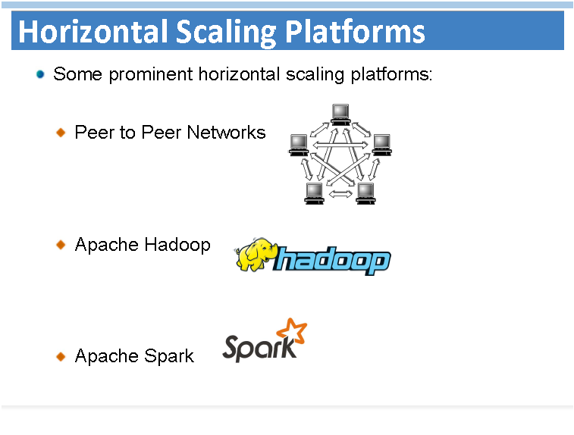

Slide 33
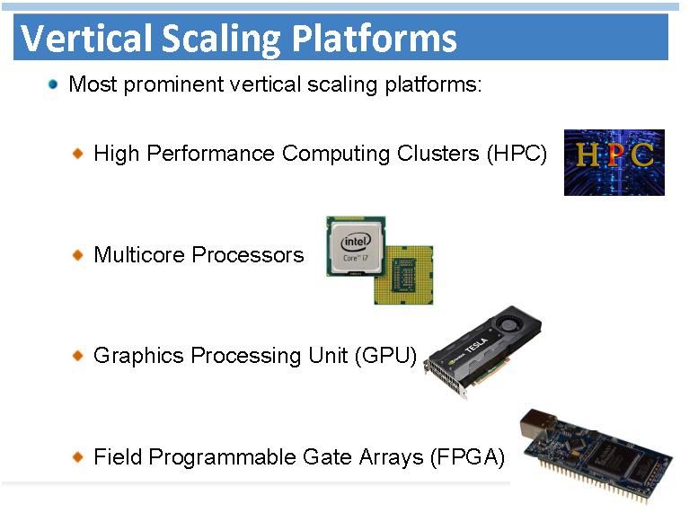

Slide 34
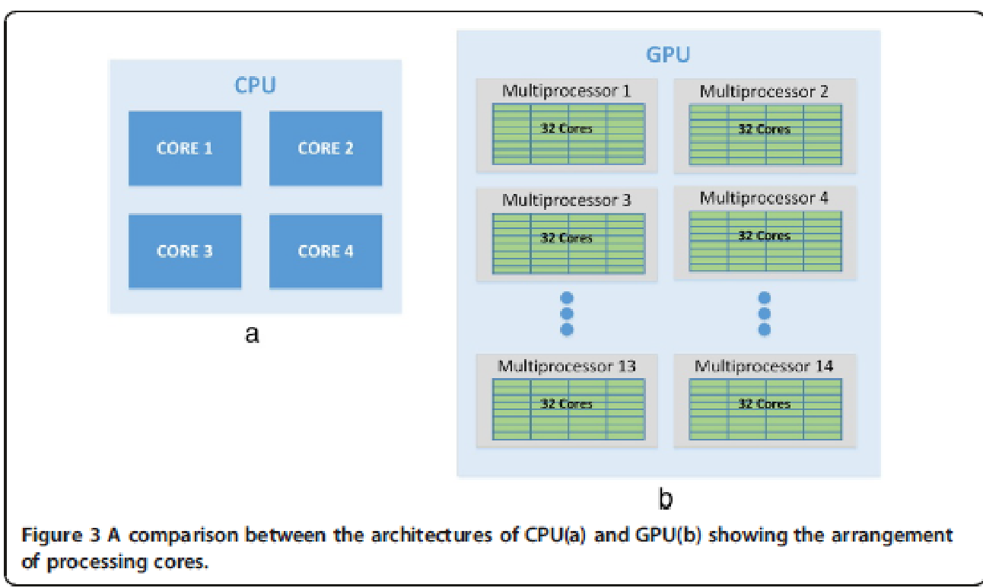
CPU Vs. GPU

Slide 35
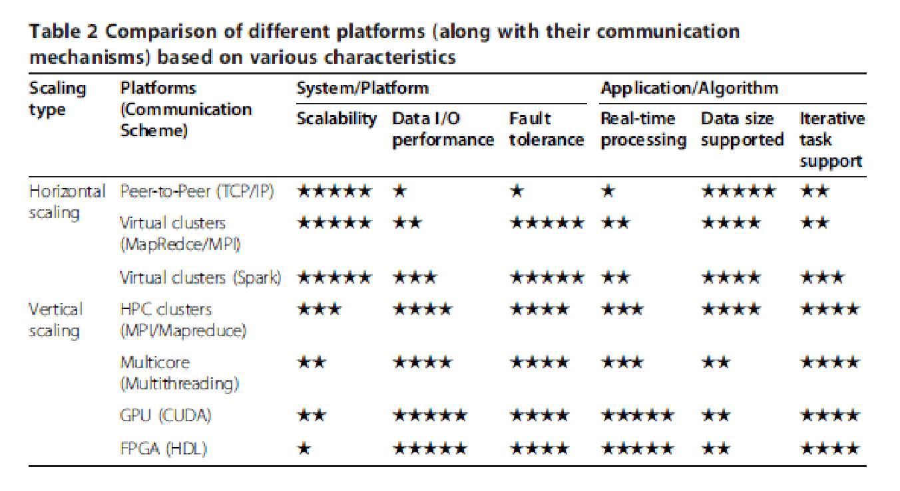
Comparison analysis

